Slide 1
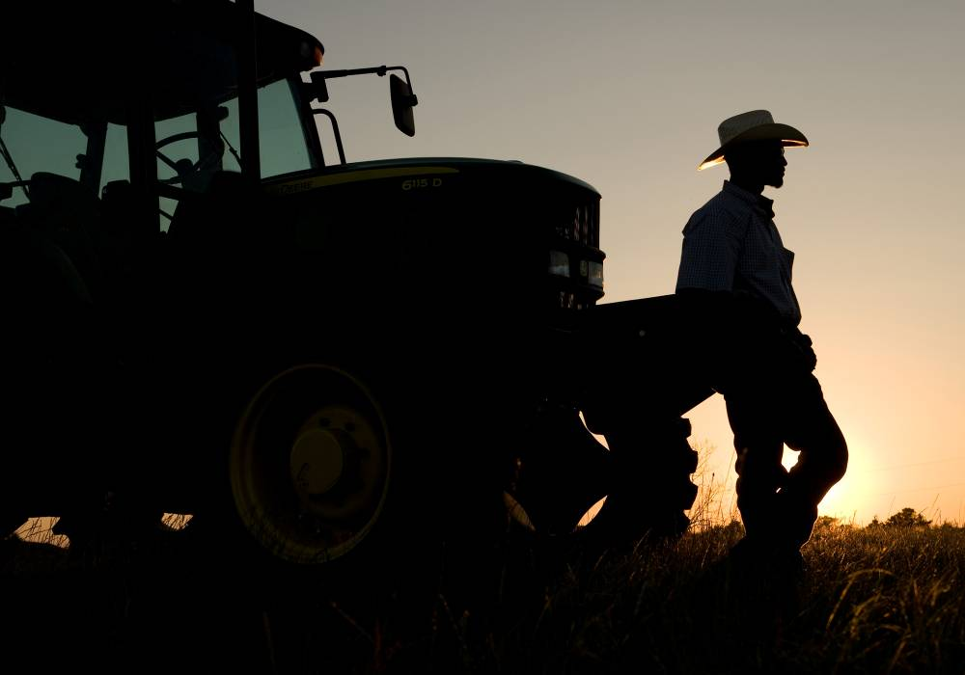
NTRA Advantage

Slide 2
Agenda
Introductions
  Joe Morris, NTRA Advantage
  John Deere attendees
Current Situation
Business Landscape
Customer Relationships
Sales Opportunities
Competition
John Deere Advantages and Unique Value
The “Main Thing”
Account Growth Plan & Strategy - 2011 NTRA Advantage
Questions

Slide 3
Current Situation
The NTRA is the league office for Thoroughbred Racing located in Lexington, KY
Membership is made of the following organizations
  60 member racetracks across the U.S. covering nearly all major markets.
  Industry membership organizations (e.g. AQHA, USEF, USTA, etc.)
  State associations for horse owners & breeders
  Equine facilities (e.g. farms, training centers, veterinary clinics, etc.)
Position and promote John Deere as the exclusive equipment vendor
NTRA owns and manages a dedicated “group purchasing” sales force that assists John Deere in generating business from the industry. The NTRA Advantage sales staff visits member farms, tracks, and attend equine events to help approved association members understand the John Deere equine programs.
Notes:
$370M since 1999. Started out with tracks, added full-time program, added coupon program.

Slide 4
Current Situation
2010 FY Equine Sales
Coupon $13,876,207 +9.1%
Full-Time $29,911,937 +6.4%
Total $43,788,144 +7.2%
Sales Branch
  Eastern +13.7%
  S. Central - 2%
  Northwest +11.8%
  Canada +9.2%

Slide 5
Current Situation
1st Time John Deere Customers
For FY2009 and FY2010, equine coupons redeemed and matched with CKC, showed that 52% of equine purchases made were by 1st time John Deere customers.

Slide 6
Current Situation
2010 Equine / Small Ag Tractor Sales Comparison
HP Category | Industry | Deere | Equine
Compacts | 2.40% | 5.40% | 14.67%
40<90 | -6.40% | 3.30% | -4.16%
90<140 | -3.80% | 1.50% | -1.35%
Total |  |  | 9.16%
Confidential & Proprietary

Slide 7
Customer Relationships
Equine Partners
The NTRA ADVANTAGE Providing Member Benefits since 2001
  Partnered with major equine groups
    AQHA – American Quarter Horse Association
    NTRA – National Thoroughbred Racing Association
    USTA / HTA – United States Trotting Association / Harness Tracks of America
    USPA – United States Polo Association
    ApHC – Appaloosa Horse Club
    USEF – United States Equine Federation
  All member benefits programs are run out of the NTRA - Lexington KY office

Slide 8
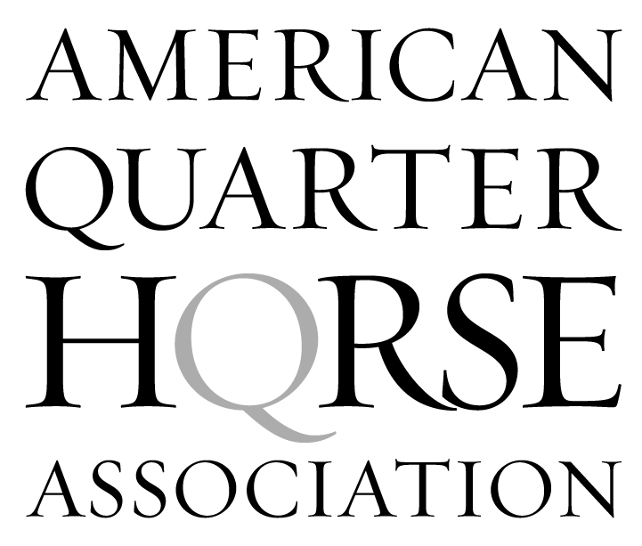
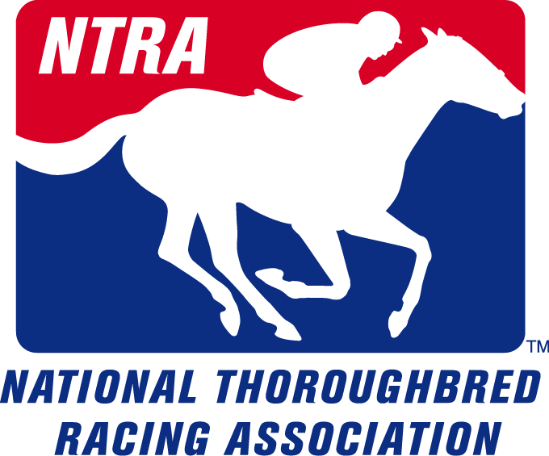





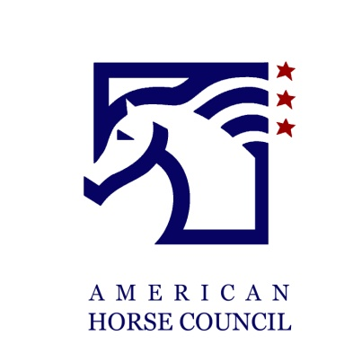

Customer Relationships

Slide 9
Customer Relationships
Loyalty to the Industry
Equine Members develop loyalty with industry partners
Revenue sharing with tracks, affiliates & horsemen’s associations

Slide 10
Sales Opportunities
Breadth of Product Across the Enterprise
  Ag & Turf products
  Construction & Forestry
  John Deere Financial
  John Deere Landscapes

Slide 11
Primary Competition
Kubota
AGCO
CNH
CAT

Slide 12
John Deere Advantages and Unique Value
Full product line across the enterprise
John Deere dealer network
Proven brand support
NTRA Advantage sales force & influence
Members are loyal to their corporate partners
John Deere recognized as equipment leader in the equine industry
Exclusive partnership – key associations as partners & support

Slide 13
The “Main Thing” – Plan to Win
Take To The Next Level
Leverage our business partner
Alignment & Collaboration across the enterprise by leveraging the expertise
Differentiate ourselves from the competition
Knowledge transfer – dealer training

Slide 14
The “Main Thing” – Plan to Win
WIN
WIN
WIN
Member gets Savings!
John Deere gets Sale!
A piece of every sale comes back to support the Industry!
Notes:
A Plan To Grow. Time to take it to the next level.

Slide 15
Joe Morris

Slide 16
Ongoing Sales Element
For ten years NTRA Advantage has been working within the horse industry, building awareness and promoting John Deere. That effort has been successful, and will be continued through 2011. As in the past, we will use shows and promotions, industry networking, advertising and media support to position John Deere as the equipment supplier that supports the horse industry.
We will be increasing our efforts and focus from shows and promotions to building relationships, and one-on-one marketing with customers. With the expertise of our current staff, these efforts will ensure our overall sales will continue to grow

Slide 17
Program Integrity
NTRA Advantage wants to re-state and re-emphasize the importance of program integrity with our John Deere program. It is and always has been the intent of this program to qualify members and make sure only full-time equine facilities are receiving the percentage discounts through our purchasing program and part-time equine members have the opportunity to utilize the coupon partner program.
With the ongoing expansion of our program and with the current expansion of our sales force, we have created a centralized audit function to make sure our program integrity stays at its highest level.
Access numbers can only be issued by sales reps after they have spoken to the member, and qualified them as a full-time equine facility. This information, previously logged on paper, is now added to the NTRACK database.
Partner coupons can only be issued by sales reps after they have spoken to the member, verified their membership has been valid for more than 90 days and added them and membership information into NTRACK.
All sales reps will get final approval from Joe Morris on any questionable farms. Jade Cook and Vicki Baumgardner, in the Accounting/Audit department, will monitor the central office. Jade and Vicki will officially inspect the records. Dwight Ange from John Deere will have access to all records pertaining to coupons issued.
With anticipated growth in sales, we felt it important to formalize and centralize this procedure previously performed at the sales representative level.
We will continue to monitor program integrity as this function remains our number one priority.

Slide 18
United States Horse Statistics
Estimated number of horses in the United States = 9.2 million
Estimated number of horses by activity:
Recreation = 3,906,923
Showing = 2,718,954
Racing = 844,531
Other = 1,752,439
Estimated number of horses by breed:
Quarter Horse = 3,288,203
Thoroughbred = 1,291,807
Other = 4,642,739
Number of people participating in the equine industry:
Owners = 2,000,000
Volunteers = 2,000,000
Direct, indirect and induced economics impacts of the equine industry on the United States:
Contributions to Gross Domestic Product (GDP) = $102 Billion
Number of full-time equivalent (FTE) jobs proceed 1.4 million

Slide 19
NTRA Member Statistics
Racing
49,000 American races
7,000 Canadian races
$11,416,570,000 Money wagered
$1,027,731,620 Purse money
5,473 Race days
Sales
$302,641,564 Yearlings
$115,116,500 2yr olds
$45,211,144 Weanlings
$149,110,144 Broodmares
$617,430,160 Total Horse Sales
TOBA Members
$8,252,860 Average net worth
$1,412,500 Value of ownership in racing and breeding stock
$1,327,270 Market value of primary residence
133.8 average acres of farm or ranch
20.3 Years with a financial interest in Thoroughbred industry
3.9 miles of fencing
83% Attend or graduated from college

Slide 20
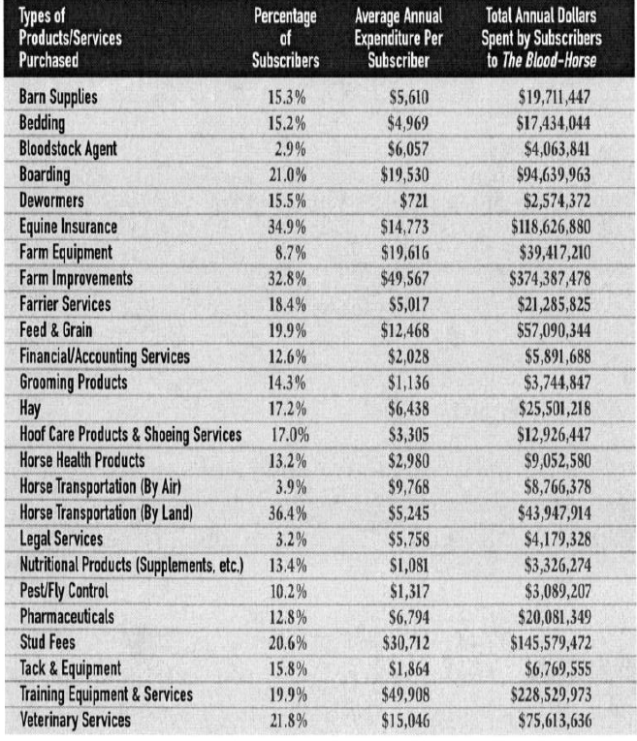
Thoroughbred Owners & Breeders

Slide 21
AQHA Member Statistics
Shows
3,149 Sanctioned shows
878,406 AQHA show entries
Racing
17,180 Starters
9,113 AQHA Races
$128 Million in Purse money
500,000 AQHA Owners ride recreational
78% AQHA members live in rural areas
82% Attended or graduated college
$1,060,00 Average net worth
$560,000 Average real estate value
21,424 Riding instructors or trainers
98% Own a computer
87.4% Own land
39.7% Own 16 to 25 acres
61% Own a full size tractor
57% Maintain 1 to 5 acres of lawn

Slide 22
USEF Member Statistics
Shows
2,800 shows per year
Members compete in at least 6 shows per year
85% are women
66% have a college degree
$185,000 Average income
38% have a net worth over $500,000
$594,000 Average market value of home
40% own a farm
66% 10 acres or more
Own an average of 4 horses

Slide 23
USEF Member Statistics
Products Average Annual Expenditure
Horse Feed $371 million
Trailers $337 million
English Tack and Saddlery $145 million
Fencing $144 million
Stable Supplies $132 million
Equine Medicines and Drugs $115 million
Equestrian Apparel $73 million
Vitamin and Mineral Supplements $47 million
Blankets and Sheets $36 million
Horse Health Care Products $36 million
Grooming Products and Equipment $30 million
Hoof Treatment $26 million
Dewormers $20 million
Fly Control $15 million
Helmets $10 million
Leather Care Products $7 million

Slide 24
Equine Affiliations
National Thoroughbred Racing Association’s (NTRA) is an association of associations: AQHA, USEF, USTA, HTA, USPA, EqCan, AHC and ApHC are our Key partners.
National Thoroughbred Racing Association Members
American Quarter Horse Association (AQHA) Members = 312,000
United States Equestrian Federation (USEF) Members = 210,000
United States Trotting (USTA)/Harness Tracks (HTA) Members= 25,000
American Horse Council Members

Slide 25
NTRA Members
National Thoroughbred Racing Association (NTRA) members:
50 NTRA racetracks
Breeders Cup
The Jockey Club
TOBA—Thoroughbred Owners and Breeders of America
AAEP--- American Association of Equine Practitioners
AFA-----American Farriers Association
HBPA—Horsemens Benevolent and Protective Association:
  Alabama, Arizona, Arkansas, Canada, Charles Town, WV, Colorado, Finger Lakes, NY, Florida, Idaho, Illinois, Indiana, Iowa, Kansas, Kentucky, Louisiana, Michigan, Minnesota, Montana, Mountaineer Park, WV, Nebraska, New England, New Mexico, Ohio, Oklahoma, Ontario, Oregon, Pennsylvania, Tampa Bay, FL, Texas, Virginia, & Washington
THA-----Thoroughbred Horsemen Association: Delaware, Illinois, Maryland, New Jersey, & New York
TOC----Thoroughbred Owners of California
CTHS – Canadian Thoroughbred Horse Society
KTOB – Kentucky Thoroughbred Owners & Breeders
KTA – Kentucky Thoroughbred Association
NYTBA—New York Thoroughbred Breeders Association
CTBA – California Thoroughbred Breeders Association
ATBA – Arizona Thoroughbred Breeders Association
WTBA – Washington Thoroughbred Breeders Association
NJTBA – New Jersey Thoroughbred Breeders Association
FLTBA—Florida Thoroughbred Breeders Association
OKTA----Oklahoma Thoroughbred Association
VTA – Virginia Thoroughbred Association

Slide 26
NTRA Members cont’d
TTA – Texas Thoroughbred Association
ITOBA – Indiana Thoroughbred Owners & Breeders Association
GTOBA – Georgia Thoroughbred Owners & Breeders Association
ATBRA – Alabama Thoroughbred Breeders Racing Association
MTOBA – Mississippi Thoroughbred Owners & Breeders Association
NCTA – North Carolina Thoroughbred Association
SCTOBA – South Carolina Thoroughbred Owners & Breeders Association
ITHA – Illinois Thoroughbred Horsemen’s Association
ITA – Idaho Thoroughbred Association
MTA – Minnesota Thoroughbred Association
MTOBA – Michigan Thoroughbred Owners & Breeders Association
ATBHA – Arkansas Thoroughbred Breeders & Horsemen’s Association
COTBA – Colorado Thoroughbred Breeders Association
WVTBA – West Virginia Thoroughbred Breeders Association
KTA – Kansas Thoroughbred Association
NTBA – Nebraska Thoroughbred Breeders Association
NETHA – New England Thoroughbred Horseman’s Association
OTBO – Ohio Thoroughbred Breeders & Owners
OTBA – Oregon Thoroughbred Breeders Association
LTBA - Louisiana Thoroughbred Breeders Association
PATBA—Pennsylvania Thoroughbred Breeders Association
MDTBA—Maryland Thoroughbred Breeders Association
SDTA – South Dakota Thoroughbred Association
THP – Texas Horseman’s Partnership

Slide 27
AQHA Members
American Quarter Horse Association (AQHA) Members = 312,000
66 AQHA member racetracks
NCHA – National Cutting Horse Association
NRHA – National Reining Horse Association
NRCHA – National Reined Cow Horse Association
NSBA – National Snaffle Bit Association
PHBA – Palomino Horse Breeders of America
IBHA – International Buckskin Horse Association
USTPA – United States Team Penning Association
CMSA – Cowboy Mounted Shooting Association
CQHA – Canada Quarter Horse Association
ESQHA – Empire State Quarter Horse Association
PQHA – Pennsylvania Quarter Horse Association
NJQHA – New Jersey Quarter Horse Association
NYSQHA – New York State Quarter Horse Association
WSQHA – Washington State Quarter Horse Association
ASQHA – Alaska State Quarter Horse Association
MSQHA – Maryland State Quarter Horse Association
VTQHA – Vermont Quarter Horse Association
ALQHA – Alabama Quarter Horse Association
PCQHA – Pacific Coast Quarter Horse Association
AZQHA – Arizona Quarter Horse Association
VQHA – Valley Quarter Horse Association
RMQHA – Rocky Mountain Quarter Horse Association
CTQHA – Connecticut Quarter Horse Association
MAQHA – Mid-Atlantic Quarter Horse Association
FQHA – Florida Quarter Horse Association
GQHA – Georgia Quarter Horse Association
IDQHA – Idaho Quarter Horse Association
ILQHA – Illinois Quarter Horse Association
INQHA – Indiana Quarter Horse Association
IAQHA – Iowa Quarter Horse Association
KSQHA – Kansas Quarter Horse Association
KYQHA – Kentucky Quarter Horse Association
LAQHA – Louisiana Quarter Horse Association
LQHBA – Louisiana Quarter Horse Breeders Association
MAQHA – Massachusetts Quarter Horse Association
MIQHA – Michigan Quarter Horse Association
MNQHA – Minnesota Quarter Horse Association
MSQHA – Mississippi Quarter Horse Association
MOQHA – Missouri Quarter Horse Association
MTQHA – Montana Quarter Horse Association
QHAN – Quarter Horse Association of Nebraska
NHQHA – New Hampshire Quarter Horse Association
NJQHA – New Jersey Quarter Horse Association
NCQHA – North Carolina Quarter Horse Association

Slide 28
AQHA Members cont’d
OQHA – Ohio Quarter Horse Association
OKQHA – Oklahoma Quarter Horse Association
ORQHA – Oregon Quarter Horse Association
PAQHA – Pennsylvania Quarter Horse Association
SCQHA – South Carolina Quarter Horse Association
TNQHA – Tennessee Quarter Horse Association
TXQHA – Texas Quarter Horse Association
UTQHA – Utah Quarter Horse Association
VAQHA – Virginia Quarter Horse Association
WIQHA – Wisconsin Quarter Horse Association

Slide 29
USEF Members
United States Equestrian Federation (USEF) Members = 210,000
American Saddlebred Horse Association
American Driving Society
American Endurance Ride Conference
American Miniature Horse Registry
American Morgan Horse Association
American Shetland Pony Club
Arabian Horse Association
Intercollegiate Horse Show Association
International Andalusian & Lusitano Horse Association
International Friesian Show Horse Association
National Walking Horse Association
Paso Fino Horse Association, Inc
United States Dressage Federation
United States Hunter Jumper Association, Inc
United States Eventing Association, Inc
United States Pony Clubs, Inc
Alabama Hunter Jumper Association
All American Andalusian Show Horse Alliance
American Connemarra Pony Society
American Hackney Horse Society
American Haflinger Registry
American Hanoverian Society
American Hunter Jumper Foundation, Inc
American National Riding Commission, Inc
American Riding Instructors’ Association
American Road Horse & Pony Association
American Vaulting Association
American Warmblood Registry
Appaloosa Horse Club
Arabian Horse Owners Foundation
Arizona Hunter Jumper Association
California Dressage Society, Inc
Certified Horsemanship Association
Colorado Hunter Jumper Association, Inc
Colorado West Hunter Jumper Association
Combined Eastern Shore Horse Shows
Connecticut Horse Shows Association, Inc
Connecticut Hunter Jumper Association
Dallas Dressage Club
Dressage Association Of Southern California
Eastern States Dressage and Combined Training Association
Equestrians’ Institute
Equestrian Trails, Inc

Slide 30
USEF Members cont’d
Foundation for the Pure Spanish Horse
Friesian Horse Society, Inc
Georgia Hunter Jumper Association, Inc
Grass Ridge Equestrian Foundation
Greater Houston Hunter Jumper Association
Gypsy Cob And Drum Horse Association
Gypsy Horse Association, Inc
Gypsy Vanner Horse Society
Hawaii Horse Shows Association
Houston Dressage Society
Howard County 4-H Horse Clubs
Hunter Jumper Exhibitors OF Oklahoma
Indiana Hunter Jumper Association
Inter-County Horsemen’s Association, Inc
Inter-State Horse Show Association, Inc
Intercollegiate Dressage Association
Intercollegiate Saddle Seat Riding Association, Inc
Interior Horse Council
Interior Horsemen’s Association
International Georgian Grande Horse Registry
International Jumper Futurity/Young Jumper Championships
Interscholastic Equestrian Association
Johnson & Wales University
Kentucky Hunter Jumper Association
Lipizzan Association Of North America
Los Angeles Hunter Jumper Association
Maine Horse Association
Marshall & Sterling League
Maryland Horse Shows Association
Massachusetts Horsemen’s Council, Inc
Maui Horse Show Association
Minnesota Hunter & Jumper Association
Missoula Horsemen’s Council, Inc
Mounted Games Across America, Inc
National Hunter Jumper Association
National Show Horse Registry
New England Dressage Association
New England Horsemen’s Council, Inc
New Hampshire Horse And Trail Association
New Mexico Hunter Jumper Association
Nor-Cal Hunter Jumper Association
North American League
North American Sportpony Registry
North Carolina Hunter Jumper Association
North Florida Hunter Jumper Association, Inc
Northeastern PA Horsemen’s Association
Orange County Horse Show Association
Oregon Dressage Society

Slide 31
USEF Members cont’d
Foundation for the Pure Spanish Horse
Friesian Horse Society, Inc
Georgia Hunter Jumper Association, Inc
Grass Ridge Equestrian Foundation
Greater Houston Hunter Jumper Association
Gypsy Cob And Drum Horse Association
Gypsy Horse Association, Inc
Gypsy Vanner Horse Society
Hawaii Horse Shows Association
Houston Dressage Society
Howard County 4-H Horse Clubs
Hunter Jumper Exhibitors OF Oklahoma
Indiana Hunter Jumper Association
Inter-County Horsemen’s Association, Inc
Inter-State Horse Show Association, Inc
Intercollegiate Dressage Association
Intercollegiate Saddle Seat Riding Association, Inc
Interior Horse Council
Interior Horsemen’s Association
International Georgian Grande Horse Registry
International Jumper Futurity/Young Jumper Championships
Interscholastic Equestrian Association
Johnson & Wales University
Kentucky Hunter Jumper Association
Lipizzan Association Of North America
Los Angeles Hunter Jumper Association
Maine Horse Association
Marshall & Sterling League
Maryland Horse Shows Association
Massachusetts Horsemen’s Council, Inc
Maui Horse Show Association
Minnesota Hunter & Jumper Association
Missoula Horsemen’s Council, Inc
Mounted Games Across America, Inc
National Hunter Jumper Association
National Show Horse Registry
New England Dressage Association
New England Horsemen’s Council, Inc
New Hampshire Horse And Trail Association
New Mexico Hunter Jumper Association
Nor-Cal Hunter Jumper Association
North American League
North American Sportpony Registry
North Carolina Hunter Jumper Association
North Florida Hunter Jumper Association, Inc
Northeastern PA Horsemen’s Association
Orange County Horse Show Association
Oregon Dressage Society

Slide 32
USEF Members cont’d
Pacific Coast Horse Shows Association
Peruvian Horse Breeders & Owners
Professional Horsemen’s Association
Rhode Island Horsemen’s Association
Rocky Mountain Dressage Society
Rocky Mountain Horse Association
Sacramento Area Hunter Jumper Association
Saddleseat & Western School League Of Greater Los Angeles
San Fernando Hunter Jumper Association
Shelby Farms Equestrian Alliance
Southern KY Team Penning Association, Inc
Southern Nevada Hunter Jumper Association
Southwest Virginia Hunter Jumper
South Carolina Hunter Jumper Association
Tambourine Vaulters
Texas Hunter Jumper Association
Tri County Riding Association
United Professional Horsemen’s Association
United States Driving For The Disabled, Inc
United States Equestrian Drill Association
United States Lipizzan Registry
United States Mounted Games Association
United States Para-Equestrian Association
Utah Hunter Jumper Association, Inc
Vermont Hunter Jumper Association
Virginia Pony Breeders Association
Washington Hunter Jumper Foundation
Washington State Horsemen
Washington State Hunter Jumper Association
Welsh Pony & Cob Society Of America, Inc
West Tennessee Hunter Jumper Association
Wisconsin Hunter & Jumper Association, Inc
Woodside Vaulters

Slide 33
USTA/HTA Members
United States Trotting (USTA)/Harness Tracks (HTA) Members= 25,000
61 USTA/HTA member racetracks
New York Off-Track Betting
Freehold Racing Association
Capital District Off-Track Betting Association
MSBA – Maryland Standardbred Breeders Association
SBAP - Standardbred Breeders Association of Pennsylvania
DSBF - Delaware Standardbred Breeders Fund
SBOANJ – Standardbred Breeders & Owners Association of New Jersey
HHBNYS – Harness Horse Breeders of New York State
OHHA – Ohio Harness Horsemen’s Association
ISA – Indiana Standardbred Association
VSBF – Virginia Standardbred Breeders Fund
ISBF – Illinois Standardbred Breeders Fund
FSBOA – Florida Standardbred Breeders & Owners Association
MSBA – Michigan Standardbred Breeders Association
MSBOA – Maine Standardbred Breeders & Owners Association

Slide 34
Horse Council Members
American Horse Council Members
1300 Independent members
450 Horse Organizations
AHC State Horse Council Members
AHC State Horse Council Advisory Committee
Alabama Horse Council
Arizona State Horsemen's Association
Bay State Trail Riders Association
California State Horsemen's Association
Colorado Horse Council
Connecticut Horse Council
Delaware Equine Council
Georgia Horse Council
Greater Houston Horse Council
Horsemen's Council of Illinois
Idaho Horse Council
Iowa Horse Council
Kansas Horse Council
Kentucky Horse Council
Louisiana Equine Council
Maine Farm Bureau Horse Council
Maryland Horse Council
Michigan Horse Council
Minnesota Horse Council
Mississippi State Equine Association
Nassau-Suffolk Horsemen's Association
New England Horsemen's Council
New Hampshire Horse Council
New Jersey Horse Council, Inc
New Mexico Horse Council, Inc
New York State Horse Council, Inc
North Carolina Horse Council
Oklahoma Horse Industry Council
Oregon Horsemen's Association
Pennsylvania Equine Council
South Carolina Horsemen's Council
South Dakota Horse Council
Tennessee Horse Council
Texas Horse Council
Utah Horse Council
Vermont Horse Council
Virginia Horse Council
Washington State Horse Council
Wisconsin State Horse Council
Wyoming Horse Council

Slide 35
Industry Events
January 2011
Denver Stock Show
NTRA Eclipse Awards
FL Farm Manager's Club Meeting
Winter Equestrian Festival
Horse Shows in the Sun
USEF Annual Meeting & Convention
KY Farm Manager's Club Meeting
UPHA Convention
Heritage Place Horse Show
February 2011
Scottsdale Arabian
Equine Canada Annual Convention
FL Farm Manager's Club Meeting
Horse Shows in the Sun
Winter Equestrian Festival
CV Whitney Polo Tournament
American Saddlebred Horse Association Convention
KY Farm Manager's Club Meeting
National Farm Machinery Show
Forth Worth Stock Show

Slide 36
Industry Events
March 2011
Winter Equestrian Festival
Live Oak Driving Competition
FL Farm Manager's Club Meeting
Fasig-Tipton Horse Sale
OBS Horse Sale
US Open Polo Tournement
KY Farm Manager's Club Meeting
Bluegrass Spring
AQHA Convention
Texas Thoroughbred Association Yearling Sale
TTA/TQHA Annual Meeting
HTA/TRA Annual Meeting
April 2011
FL Farm Manager's Club Meeting
US Open Polo Tournement
Rolex Three Day Event
KY Farm Manager's Club Meeting
QuarterFest 2010
Fasig-Tipton Horse Sale Apr-11 Mid-West Horse Fair

Slide 37
Industry Events
May 2011
FL Farm Manager's Club Meeting
Kentucky Oaks and Derby
KY Farm Manager's Club Meeting
High Hope Steeplechase
Preakness Stakes
Fasig-Tipton Horse Sale
June 2011
AHC Annual Meeting
FL Farm Manager's Club Meeting
FLTB Annual Meeting
KTFMC Challenge Cup Golf Scramble
Junior League Horse Shows
KY Farm Manager's Club Meeting
My Lady's Manor Steeplechase
Devon Horse Show
Belmont Stakes
NHRA Derby
Battle of the Saddle Events
Track Superintendent Field Day
AQHA Corporate Partner Summit

Slide 38
Industry Events
July 2011
FL Farm Manager's Club Meeting
North American Junior & Young Rider Championships
KY Farm Manager's Club Meeting
Fasig-Tipton Horse Sale
Polo in the Park
August 2011
FL Farm Manager's Club Meeting
AQHA Racing
Arlington Million
WCHS/KY State Fair
KY Farm Manager's Club Meeting
National Dressage Selection Trials
Annual Hambletonian Charity Golf Tournament
Hambletonian Festival of Racing
Sword Dancer
NYTB Annual Meeting
Fasig-Tipton Horse Sale
AQHYA World Show
National Copper Cup

Slide 39
Industry Events
September 2011
Delaware Park Horsemen Classic Golf Tournament
FL Farm Manager's Club Meeting
TOBA National Awards Dinner
KY Farm Manager's Club Meeting
Little Brown Jug
Bayer Select World Show
October 2011
Cal Cup Day
FL Farm Manager's Club Meeting
AQHA Racing
Fasig-Tipton Horse Sale
KY Farm Manager's Club Meeting
Maryland Million
NYTB Showcase Day
SE Circuit Congressional Cup
Appaloosa World Show
Washington International

Slide 40
Industry Events
November 2011
The Royal Agricultural Fair and Horse Show
FL Farm Manager's Club Meeting
BC Horsemen Breakfast
Breeders' Cup World Championships
KY Farm Manager's Club Meeting
MBNA American Challenge Championships Racing
AQHA World Show
December 2011
Racing Symposium
FL Farm Manager's Club Meeting
KY Farm Manager's Club Meeting
NRHA Futurity

Slide 41
Print Advertisements
Monthly Opportunities
  AQHA - America's Horse & The Racing Journal
  The Blood-Horse
  California Thoroughbred Breeders Association
  Equine Vet Education
  Florida Horse
  Hoof Beats
  Illinois Racing News
  Mid-Atlantic Thoroughbred
  New York Breeders, New York Sire Stakes & New York Thoroughbred Horsemen Association
  Various State Association Publications
  Thoroughbred Times & Thoroughbred Times Today
  U.S. Polo - Polo Players Edition
  USEF Equestrian
  Canada-Courrier Hippique
  Canada-Equine Canada
  Canada-Horse Canada
  Canada-Show Trail

Slide 42
Television Media
Three (3) commercial :30 units in Breeders’ Cup Challenge programming (Summer/Fall)
  ESPN
  ESPN2
Four (4) commercial :30 units on the Breeders’ Cup Championship broadcast (November)
  ESPN
  ESPN2
  ABC

Slide 43
Internet
  John Deere web banners on the following affiliations webpage:
    www.ntra.com
    www.bloodhorse.com
    www.drf.com
    www.aqha.com
    www.usef.org
    www.breederscup.com
    www.ustrotting.com
    www.equinecanada.ca

Slide 44
Social Media
  National Thoroughbred Racing Association
  - Facebook
  - Twitter
  - Blogs
  Breeders' Cup
    Facebook
    Twitter
    Blogs
  Affiliation Groups
    Facebook
    Twitter
    Blogs

Slide 45
Direct Mail
Monthly
  NTRA General Packets
  AQHA General Packets
  USTA/HTA General Packets
  USPA General Packets
  Equine Canada General Packets
Special Opportunities
  State Association Check/Invoice Stuffers
  Racetrack Payroll Stuffers
  Breeders’ Cup Nominators

Slide 46
E-News/E-Mail
Weekly
  USEF Weekend Review
Quarterly
  NTRA
  AQHA
  USTA
  USPA
  Equine Canada
  Canada Provinces

Slide 47
Dealer Trainings
We will increase our efforts with Territory Managers, dealers in the territories and assist them in reaching our members. This effort alongside our joint marketing message through print, direct mail, electronic and social media will help us greater penetrate into our equine industry.

Slide 48
Overall Sales Goals
NTRA Advantage’s approach to equine sales will be similar to previous years. The sales are relationship-based, with us continuing to build stronger relationships with our members, thus making it easier to sell. We will continue to focus on areas of opportunity: tracks, farms, and training facilities and part-time horse owners. This year we will continue our focus on a state-by-state approach towards setting goals and profiling and getting this information into our NTRACK database.
Each sales representative will be responsible for selling and building relationships to all breeds and disciplines within their territory and will be required to visit at least 300 facilities in their territory.
We will continue to attend some key events, but will focus staff on one-on-one marketing to key customers. We will be using some retired John Deere employees to help us at the shows.

Slide 49
Goals Summary by Breed
Breed 2011 Goal
NTRA $ 8,880,000
AQHA $18,605,000
USEF $ 4,580,000
Other $ 2,100,000
Canada $ 6,100,000
Construction $ 700,000
Tracks $ 6,800,000
TOTAL $47,765,000

Slide 50
Goals Summary by Rep/Region
Rep Territory 2011 Goal
S. Driskill SW, Tracks, Canada $13,010,000
J. Lawson NE, MA, Canada $12,065,000
L. Carlisle Great Lakes & SE $ 6,470,000
S. Parks FL & Tracks $ 8,320,000
M. Hoffman West Coast & Canada $ 2,000,000
KY Split Carlisle & Lawson $ 3,920,000
Construction Morris $ 700,000
A. Johnson NE & WY $ 1,280,000
TOTAL $47,765,000

Slide 51
NTRA Advantage
OFFICE LOCATION NTRA Advantage 2525 Harrodsburg Road, Suite 430 Lexington, KY 40504 Telephone: 866-678-4289 Facsimile: 859-245-6868 EXECUTIVE DEPARTMENT Joseph P. Morris, Jr. Senior Vice-President jmorris@ntra.com 859-422-1225 Office Heather Brown Office Manager hbrown@ntra.com 859-422-1201 Office Fred Vickers Director of Production fvickers@ntra.com 859-422-2606 Office | SALES STAFF Susan Parks Sales Representative (FL/Tracks Territory) sparks@ntra.com 352-362-2366 Cellular Steven Driskill Sales Representative (Southwest Territory) sdriskill@ntra.com 918-830-1906 Cellular Lauren Carlisle Sales Representative (Great Lake/SE Territory) lcarlisle@ntra.com 859-806-1086 Cellular Jim Lawson Sales Representative (NE/Mid-Atlantic/Canada Territory) jlawson@ntra.com 859-967-6496 Cellular Meganne Hoffman Sales Representative (West Coast Territory) mhoffman@ntra.com 317-752-8377 Cellular | SUPPORT STAFF Anna Johnson ajohnson@ntra.com 859-422-1210 Office Jade Cook jcook@ntra.com 859-422-1212 Office Taylor Porter (Intern) tporter@ntra.com 859-422-1200 Office Creative Services C. Bryan Pettigrew Consultant - NTRA Advantage bryan@affinitysportsmarketing.com 817-825-1375 Cellular

Slide 52
NTRA Advantage
2011 Sales Territories
WA
MT
ME
ND
OR
VT
NH
MN
ID
SD
WI
NY
MA
WY
MI
CT
RI
IA
PA
NV
NE
NJ
IL
IN
OH
MD
CA
UT
WV
DE
CO
VA
KS
MO
KY
SPLIT TERRITORY
NC
TN
AZ
NM
OK
AR
SC
MS
AL
GA
TX
LA
Steve Driskill
Lauren Carlisle
James Lawson
Susan Parks
Meganne Hoffman
Anna Johnson
FL
James Lawson & Lauren Carlisle

