Slide 1
AAEP RACEDAY INJURY MANAGEMENT
Lynn Rolland Hovda, DVM, MS
Chief Commission Veterinarian
Minnesota Racing Commission

Slide 2
AAEP
American Association of Equine Practitioners
Founded in 1954
Dedicated to health and welfare of the horse
9000 members worldwide
All breeds, all breed organizations
Racing Committee developed guidelines for race day injury management

Slide 3
AAEP Racing Committee February 2016
Staffing and Personnel
Automotive Equipment – Equine ambulance and chase vehicle
Emergency treatment
Communication
Injury Management Duties
Media Relations

Slide 4
Goals
Reduce occurrence and severity of equine injuries
Provide emergency management for injured horse
Rapid response
Accurate assessment
Best management possible

Slide 5
Injury Management Plan
Important to plan
Execute your plan
All emergency personnel involved
Specific locations
Specific duties

Slide 6
CBY Plan
Commission veterinarians
Practicing veterinarians (“backside DVMs”)
CBY Director of Security
Track superintendent
Chase truck driver / starting gate
Ambulance driver
Outriders
U of M Veterinary Diagnostic Laboratory

Slide 7
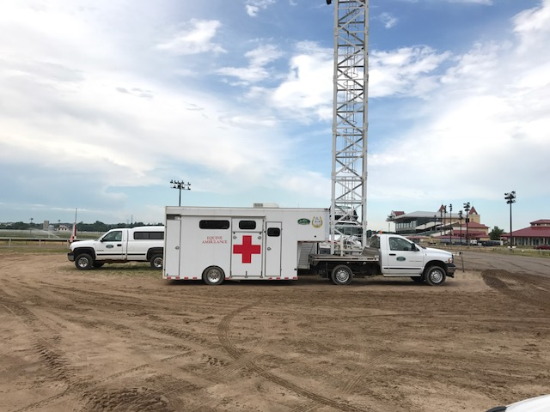
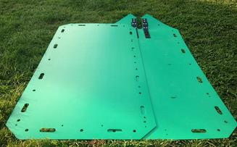
CBY Discussion Items
On and off the racing surface
Dirt track
Turf track
Between the two
Other areas
Ambulance driver skills
Backing !
Use of equine slide
Gate Injuries

Slide 8
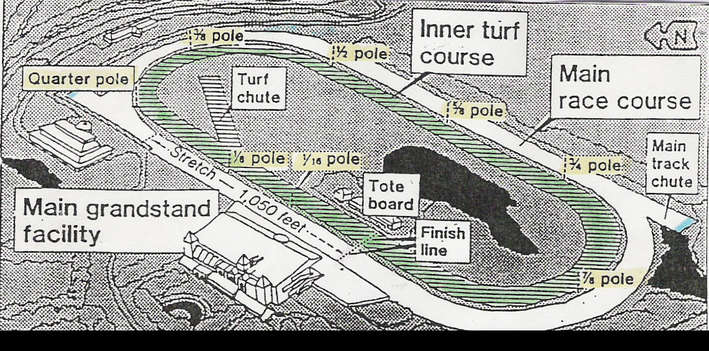

Slide 9
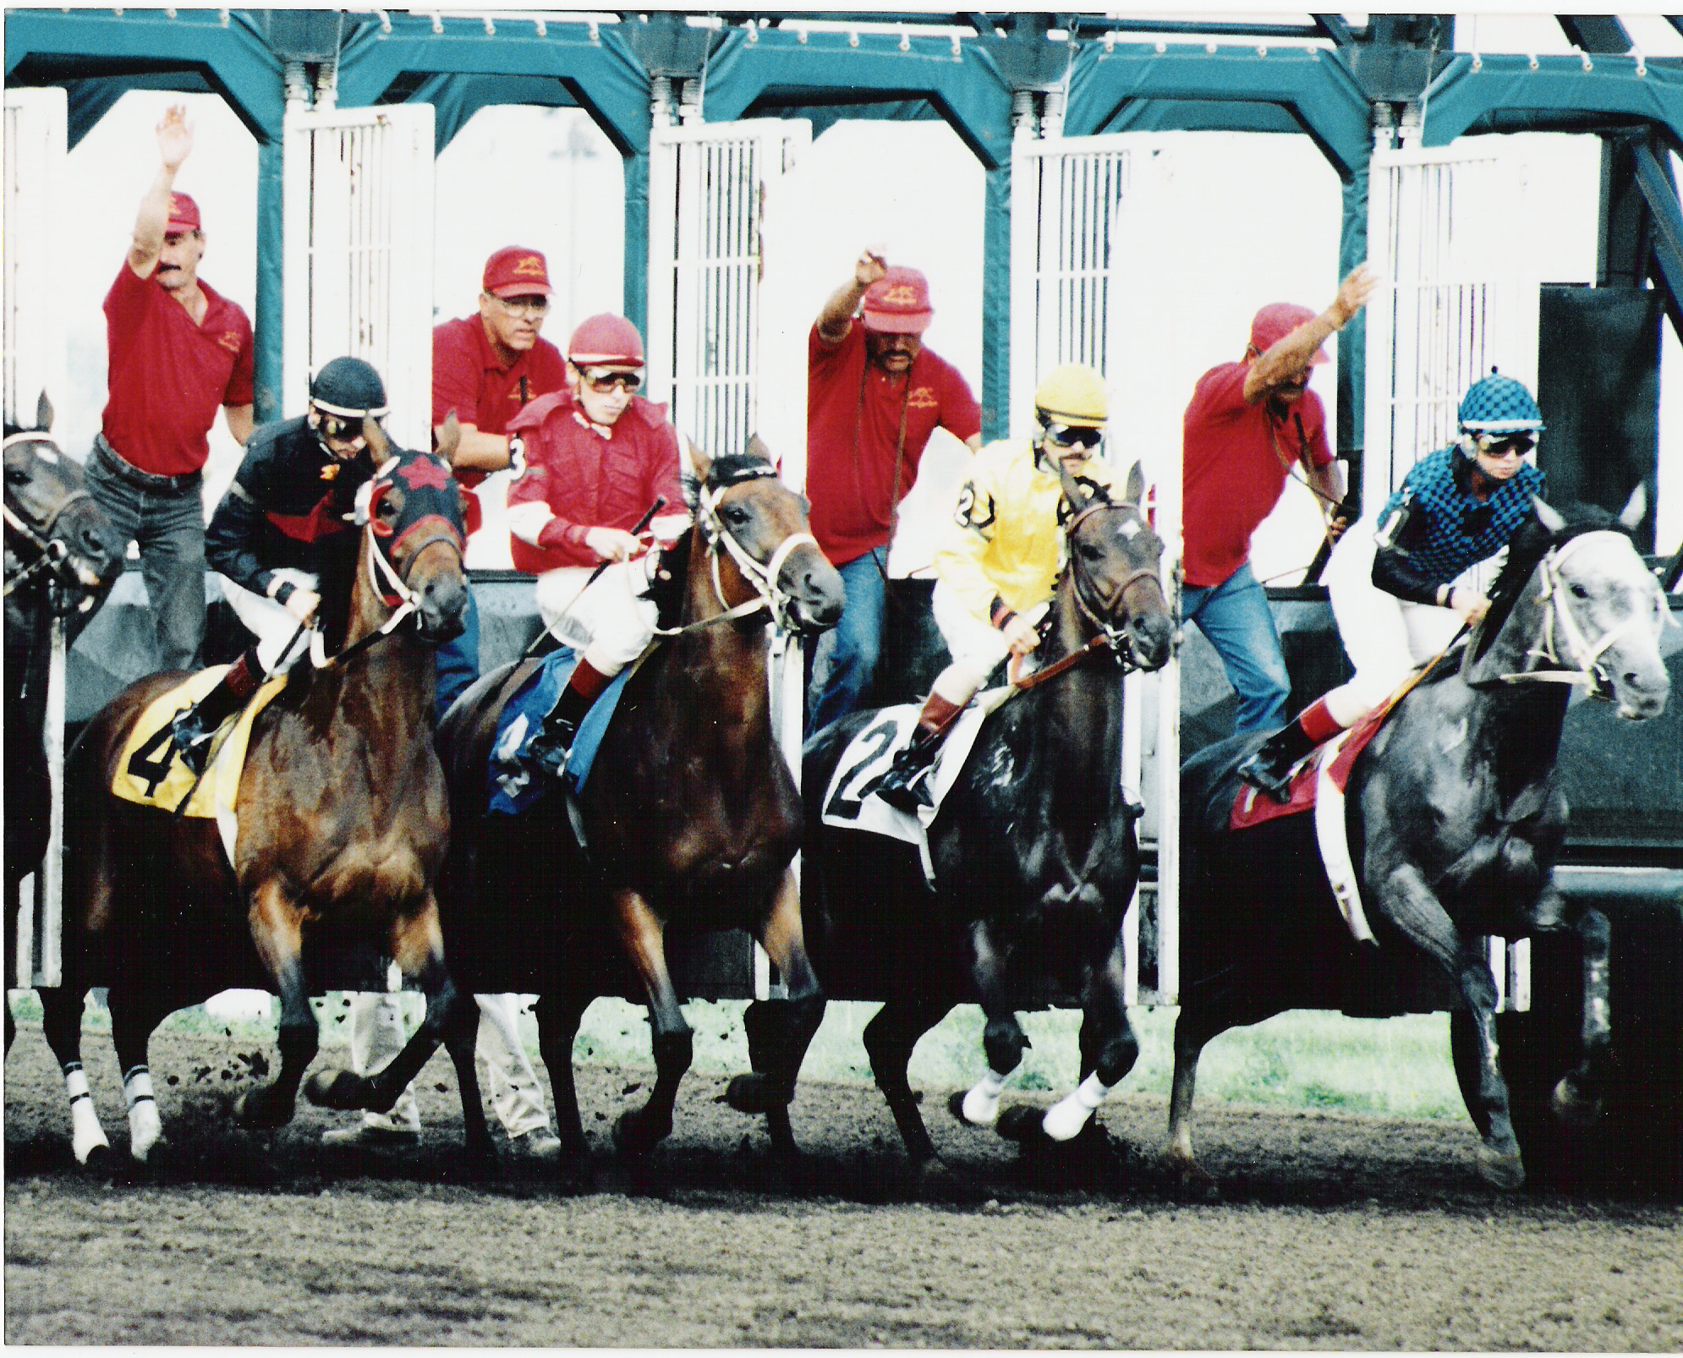

Slide 10
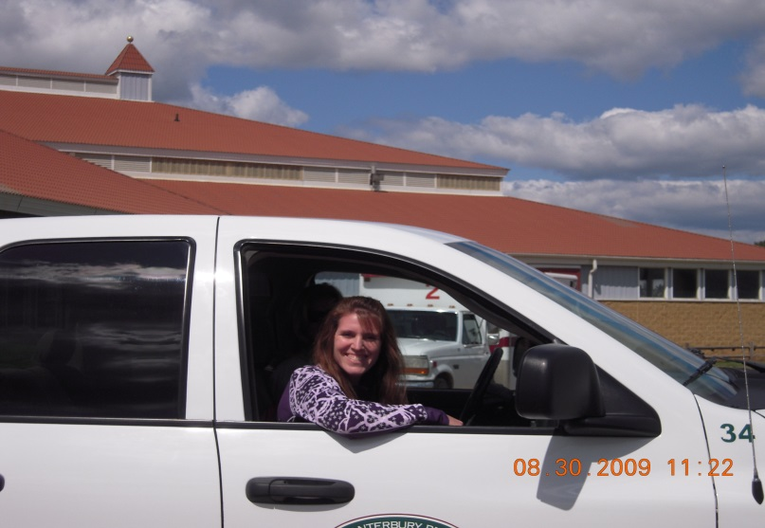
AAEP Injury Management Personnel
Veterinarians
Minimum of two for track
Horse handler
Skilled
“Screening” personnel
Trained in use and placement

Slide 11
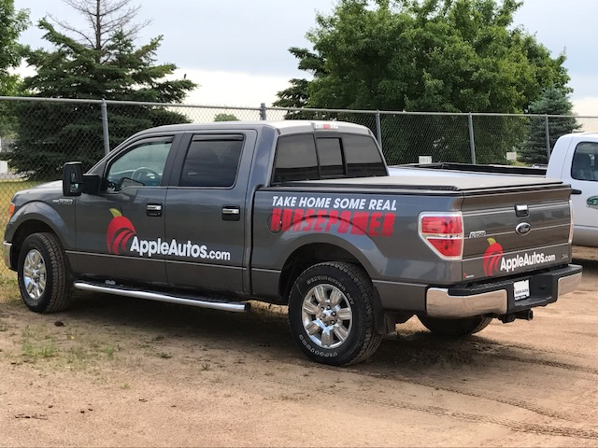
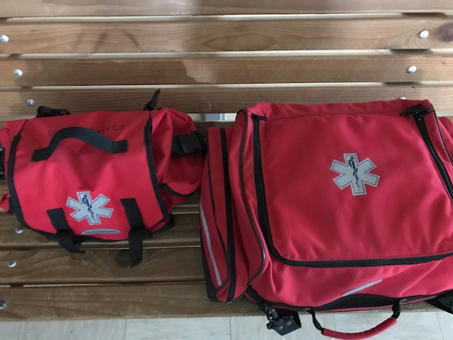
AAEP Injury Management Equipment
Chase vehicle
Equine ambulance(s)
Emergency bags or boxes

Slide 12
Chase Vehicle
DVM in vehicle to follow the field
Staffed with driver able to handle injured horse
Unacceptable for DVM to travel on foot
Using human ambulance not recommended
Need appropriate plan for sloppy conditions
CBY plan for turf races

Slide 13
Equine Ambulance(s)
Primary and backup ambulance
Primary staffed with driver when horses are on the track
Positioning – between horse and public
Other features
Lowers to ground
Sliding center partition
Human barrier
Winch and slide

Slide 14
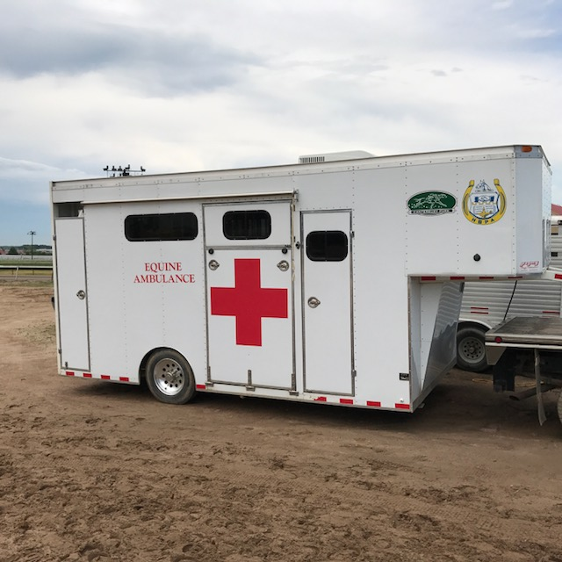
CBY ambulances
Primary – few additions
Air conditioner
Water tank
Screens
Doors
Secondary
Transport to UMVDL
Winch and long cable for pool area

Slide 15
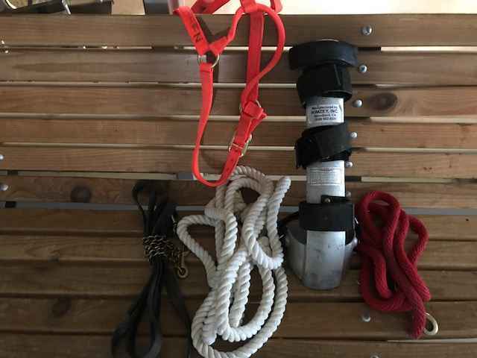
Ambulance / Chase Vehicle Equipment
Medication Bag
Kimzey splint / compression boot
Bandage material
Halters and lead shanks
Ice water, buckets, etc. (CBY – ice blanket)
Curtains or screens
Rescue sled
Bolt cutters

Slide 16
Emergency Bags
Contents vary by
Racing jurisdiction
Location on track (paddock, chase vehicle ,etc.)
AAEP Recommendations
Sedative
Short acting corticosteroid
Euthanasia solution
Needles/syringes
Vet Wrap and pads
Stethoscope
Supplies to collect blood samples

Slide 17
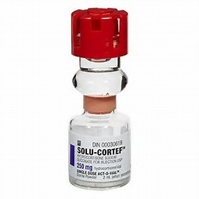
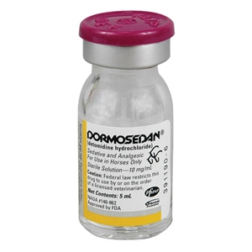
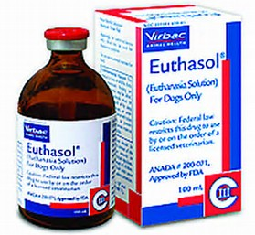
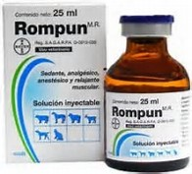
AAEP Recommended Medications

Slide 18
Large Bag – Chase Vehicle

Slide 19
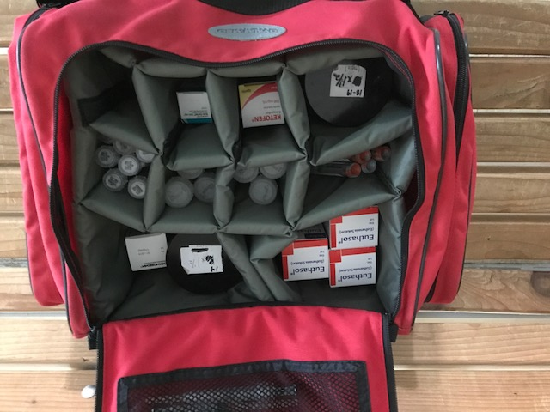

Slide 20
Small Bags Paddock, Office, Detention Barn

Slide 21
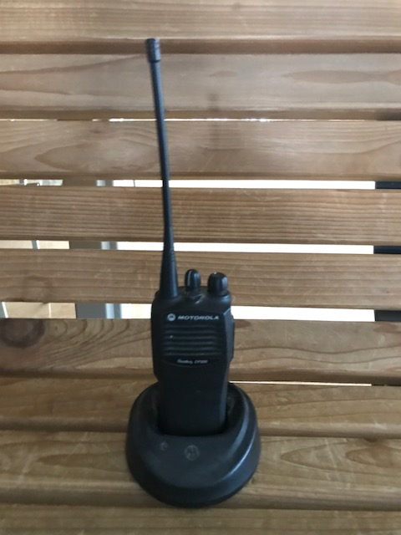
AAEP Injury Management Communication
Two way radios
Best practice - separate channel for private conversation
Cell phones
Group listing of important numbers
Transfer to private practitioner
CBY – done in detention barn
Media
One specific DVM in charge

Slide 22
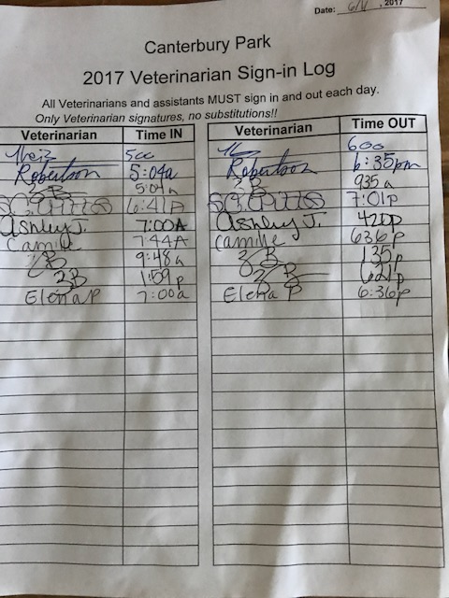

Slide 23
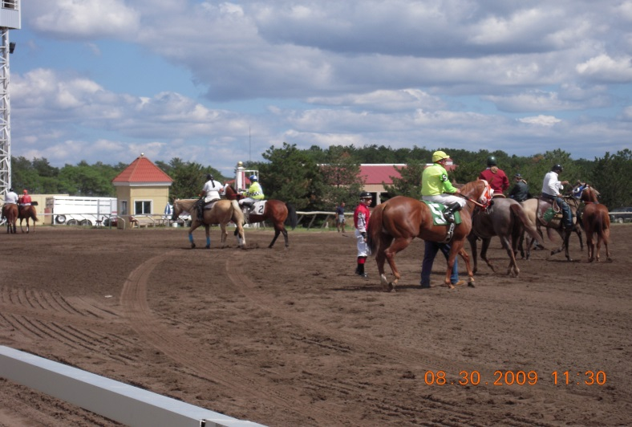
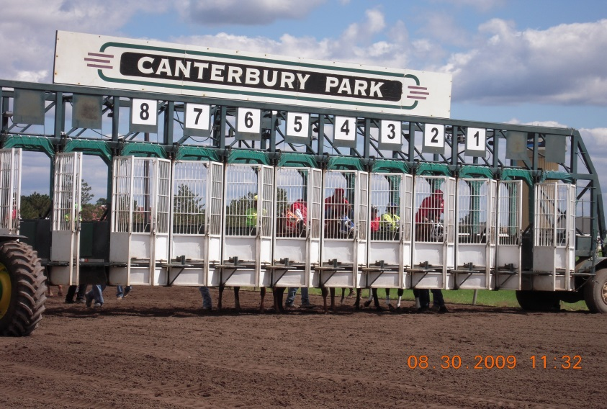
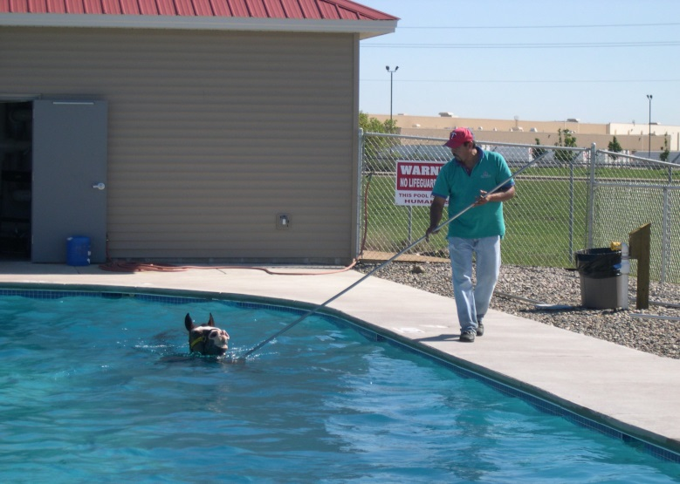
AAEP Injury Management Location
Racetrack
Paddock
Off-track (pre and post race)

Slide 24
Racetrack
Main Track
Rapid call to horse ambulance (location)
Physical and chemical restraint
Starting Gate
Observation during post parade and at gate
Examine poorly behaved horses
Consider a scratch – wounds, lame, head trauma
Turf Track
Location of on and off gaps

Slide 25
Paddock
Paddock DVM monitors horses
Consider scratch – lame, wounds, head trauma
Plan for dealing with paddock injuries
Emergency bag
Ambulance access
Screens
“People management” – security

Slide 26
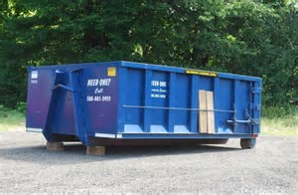
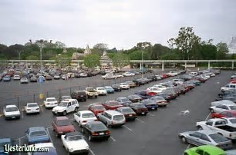
Off Track Pre and Post Race
“Horses can unexpectedly wind up in unpredictable locations on the grounds of a racetrack”
Bridle path
Parking lot
Dumpsters
Shrubs
Swimming pool
Plan for this …. And then plan again
Rapid response is necessary

Slide 27
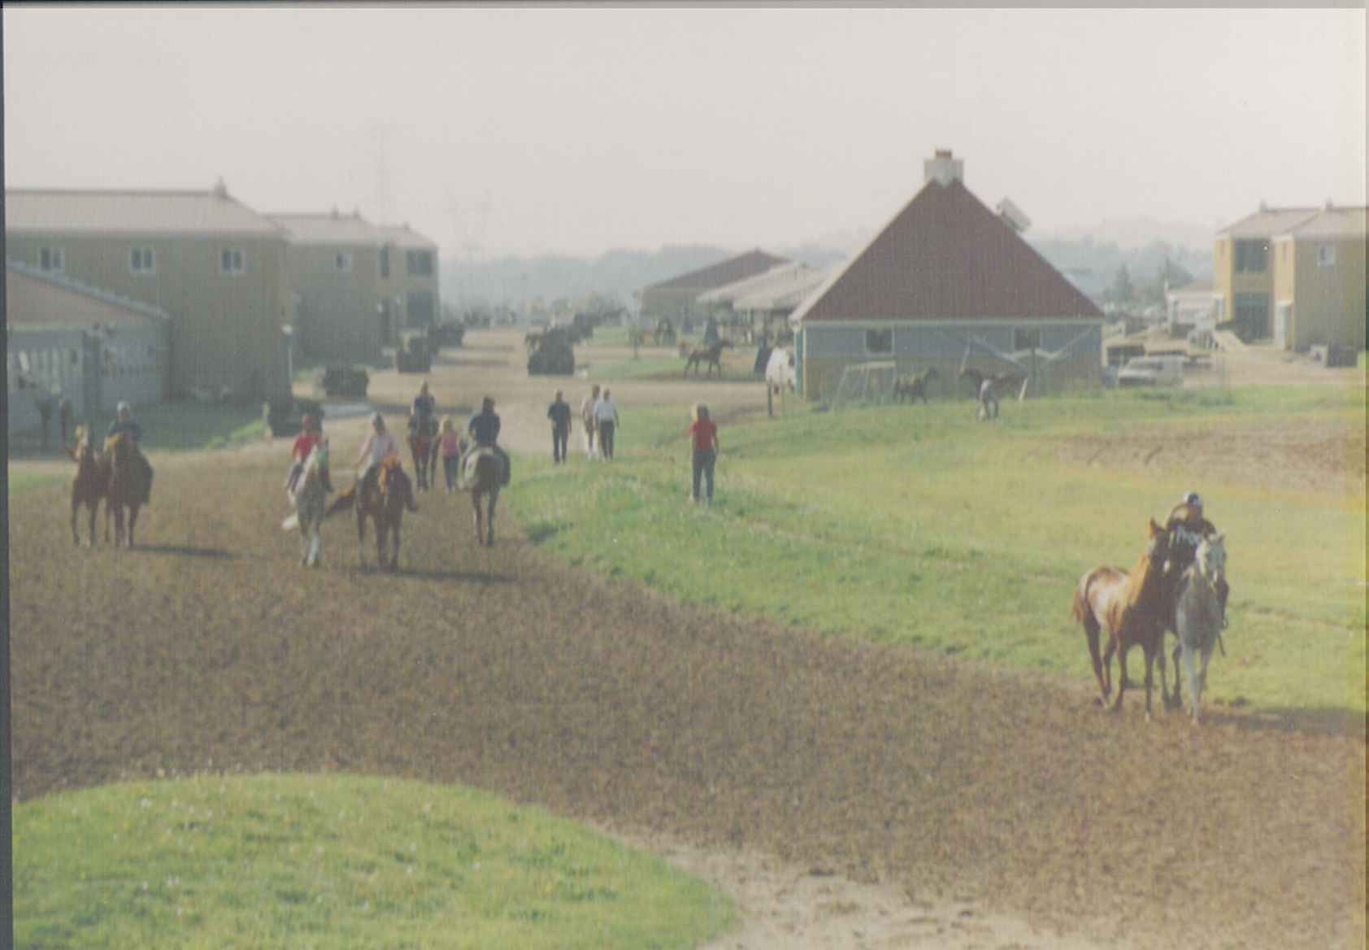

Slide 28
Special Consideration Catastrophic Injury
Prompt response
Screens if needed
Make EVERY effort to load into ambulance before euthanasia
Equine slide or rescue device
No chains or cables around the neck or limb
Secure, enclosed area for deceased horses

Slide 29
Special Consideration Multiple Incidents in Same Race
Communication is key to success
Quick assessment
CBY
All commission DVMs respond
Lead test barn technician responds as well

Slide 30
Special Consideration Heat Stroke
Ice, ice water, ice or cooling blanket, hoses, and rubbing alcohol
Necessary medications (vary by jurisdiction)
Keep horses moving if possible and then load into ambulance when calm
Note: Often not possible as they fall down on the track or in the ambulance
Address media questions

Slide 31
Ambulance Reporting Canterbury Park

Slide 32
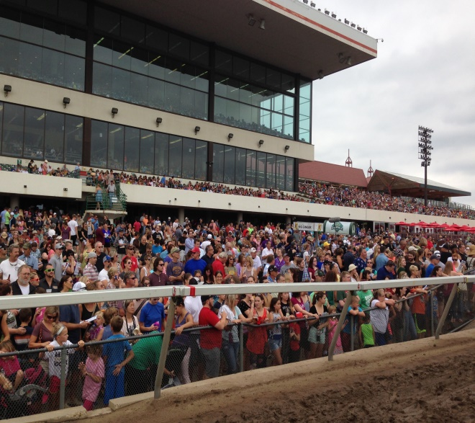
Televised Race Days Big Event Days
Extra DVM on hand
Really big events – team of specialists
Meeting with all personnel prior to event
Location of equine hospitals and mode of transportation
AAEP On Call DVMs for really big events

Slide 33
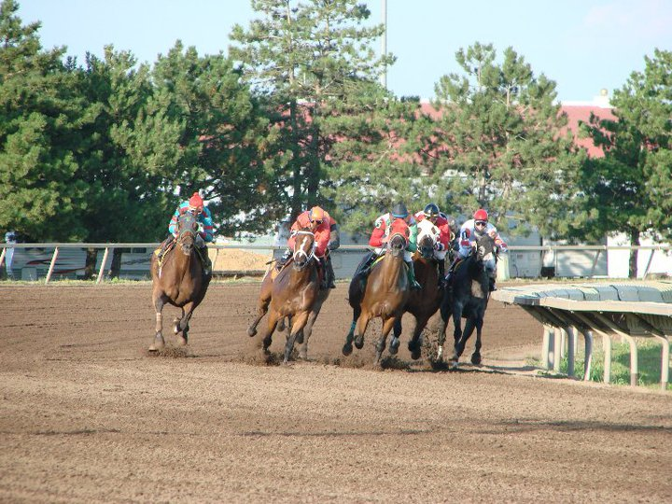
Thank You

